Slide 1

MADHURAM
Your Team

Slide 2

Project Title
Aptos Disaster Relief Crowdfunding Platform

Slide 3
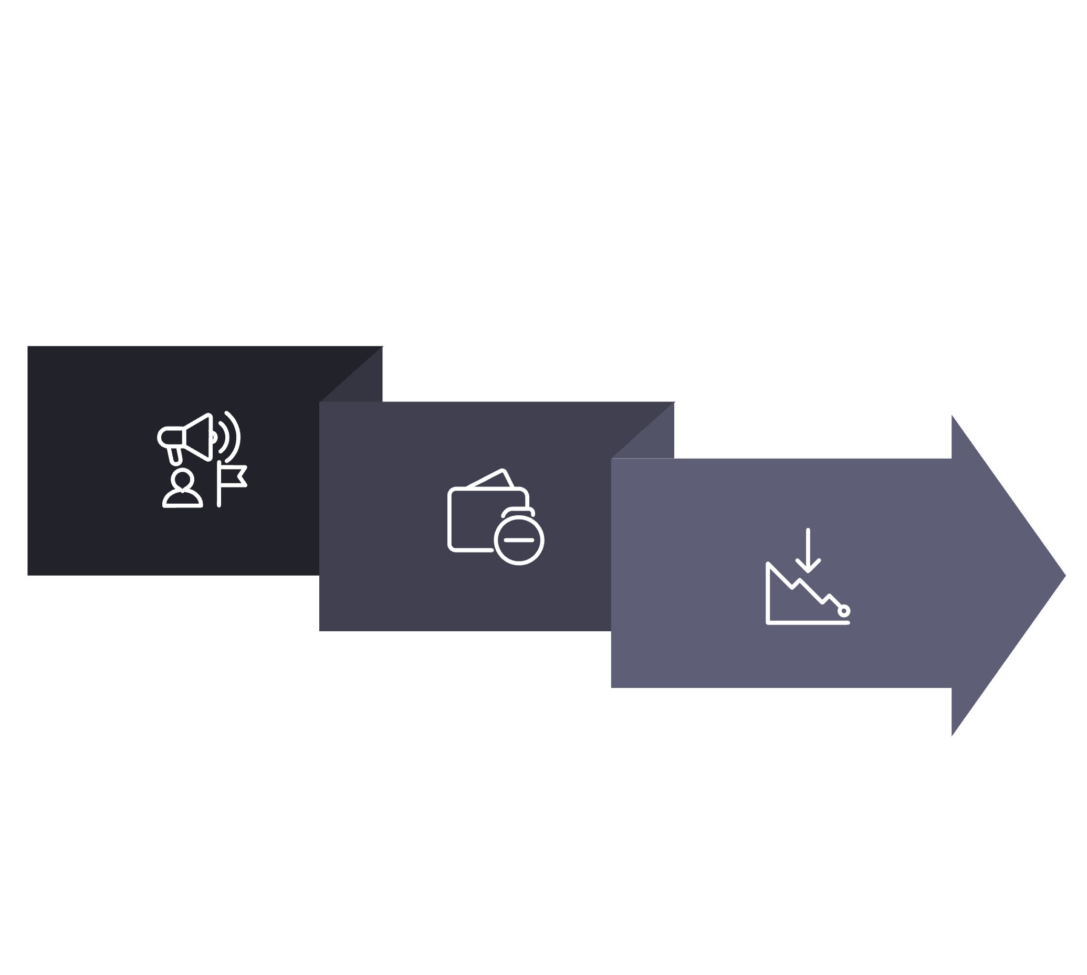



Project Description
A decentralized crowdfunding platform built on the Aptos blockchain for disaster relief campaigns. This application allows users to create, donate to, and manage disaster relief campaigns using the Petra wallet.
Create
Manage
Donate

Slide 4
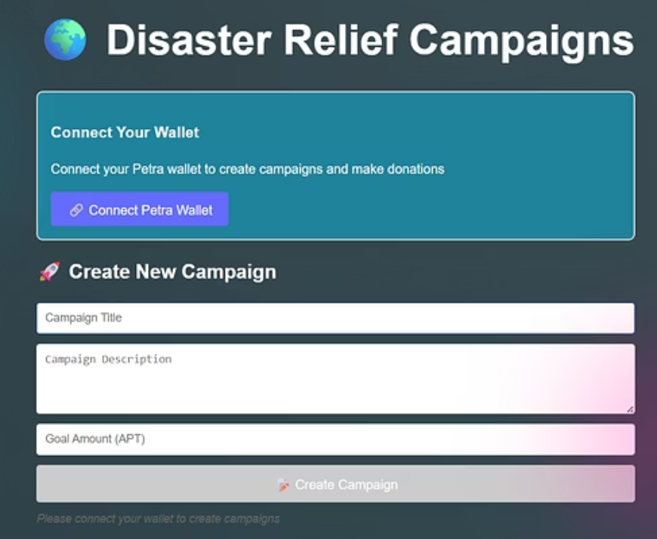
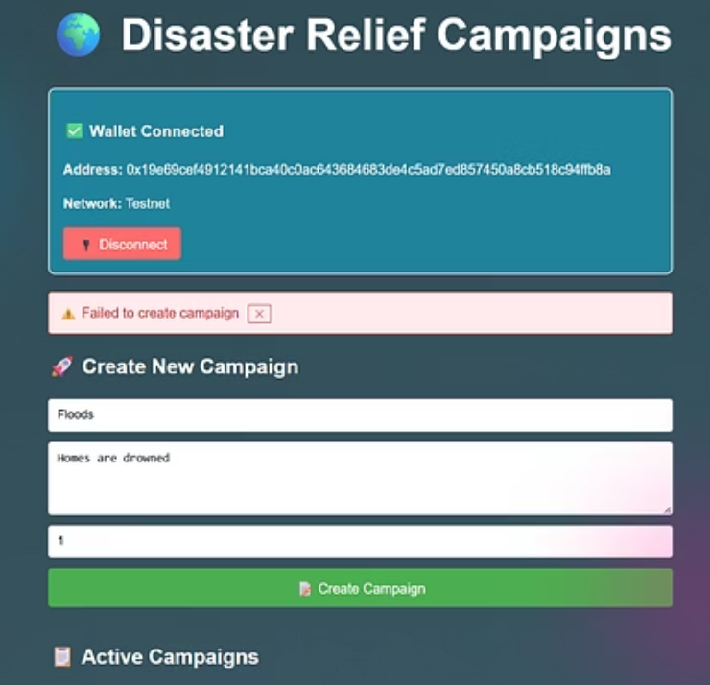
Wireframe

Slide 5

Solution
https://github.com/VamsiRaghuRam/Disaster-Relief-Crowdfunding-Platform

